Slide 1




Towards Automated Technologies in the Referencing Quality of Wikidata
Seyed Amir Hosseini Beghaeiraveri
ACM Web Conference
Ph.D Symposium
April 2022
Supervised by:
Dr Alasdair Gray
Heriot-Watt University
Co-supervised by:
Dr Fiona McNeill
University of Edinburgh

Slide 2
Outline
Wikidata
Problem:
Reference Quality
Subsetting &
Statistics
RQSS:
Referencing Quality Scoring System
Goals & Lessons Learned

Slide 3

Wikidata
A big open editable Knowledge Graph
More than 97 million items
More than 1 billion facts
Wikidata is a Verifiable KG: collection of sourced data
Most facts should indicate where the data comes from -> References
About 70 % of the facts already have got references.

Slide 4
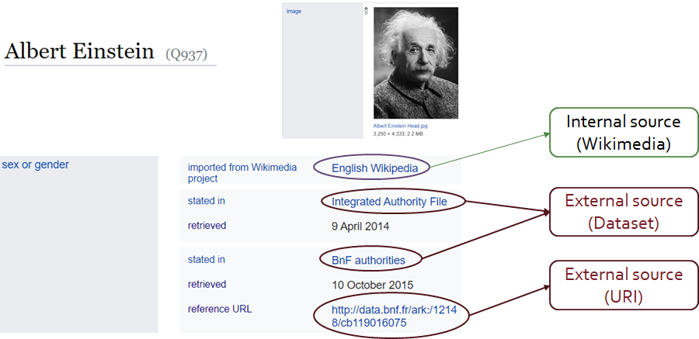
Wikidata References

Slide 5







Why References Are Important
Humans
AI
Web Search
Medical Industry

Slide 6
Now
Wikidata
Problem:
Reference Quality
Subsetting &
Statistics
RQSS:
Referencing Quality Scoring System
Goals & Lessons Learned

Slide 7

First Motivation
Lots of studies on Data Quality , very few on References:
Piscopo et al. (2017): Relevance and authoritativeness of refs
Amaral et al. (2021): An extension of Piscopo et al. on a newer dump and better ML, but still on Relevance and authoritativeness
Curotto and Hogan (2020): A proposal on using Wikipedia references for Wikidata facts (no quality assessment)

Slide 8
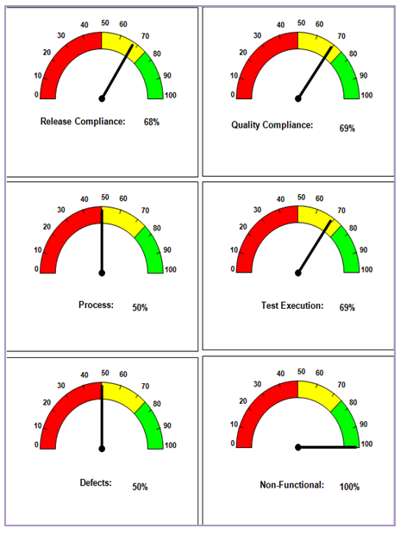

Research Questions
How we can measure the quality of references
What are the criteria
What is a good reference and a bad reference
What is the impact of bots on reference quality
How reference quality changed since 2016

Slide 9
Now
Wikidata
Problem:
Reference Quality
Subsetting &
Statistics
RQSS:
Referencing Quality Scoring System
Goals & Lessons Learned

Slide 10
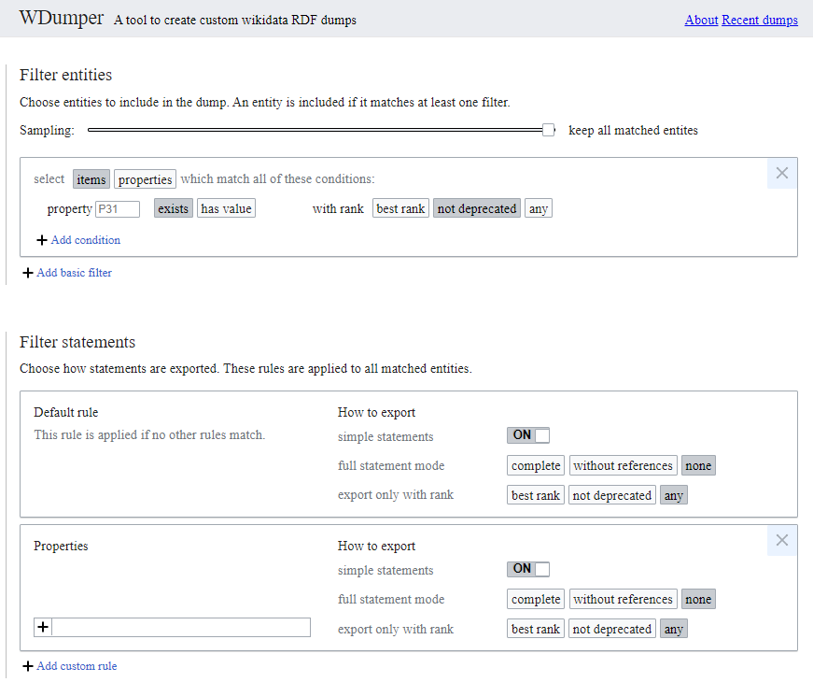
WDumper
Java-backend + Flask-frontend
Based on Wikidata Development Kit
Inputs:
A JSON specification file (Filters)
A JSON.gz Wikidata complete dump
Output:
RDF dump
demo link: Paper link:
Tool Demo: https://wdumps.toolforge.org/
Paper: Experiences of Using WDumper to Create Topical Subsets from Wikidata

Slide 11
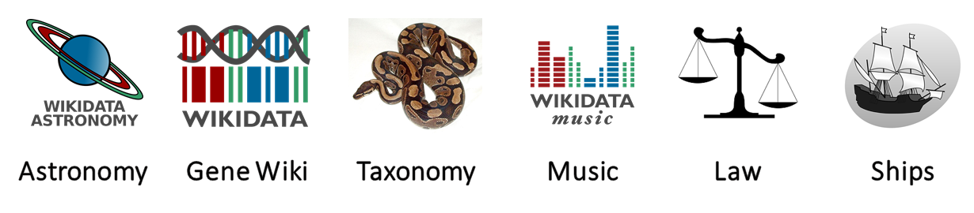
Topical Subsetting
Wikidata WikiProjects
Paper: Reference Statistics in Wikidata Topical Subsets

Slide 12
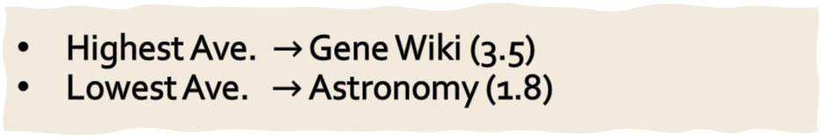
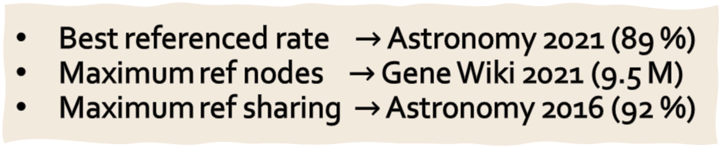
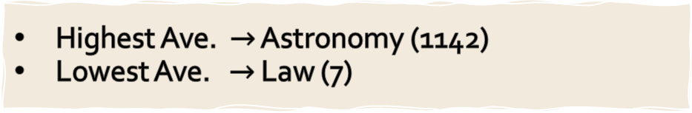
Statistical Results
Best referenced rate $→$ Astronomy 2021 (89 %)
Maximum ref nodes $→$ Gene Wiki 2021 (9.5 M)
Maximum ref sharing $→$ Astronomy 2016 (92 %)
Basic Statistics
Astronomy & Ships mostly uses internal Wikimedia sources
Gene Wiki & Taxonomy mostly uses external sources
Property Usage
Triples/Ref Nodes
Highest Ave. $→$ Gene Wiki (3.5)
Lowest Ave. $→$ Astronomy (1.8)
Highest Ave. $→$ Astronomy (1142)
Lowest Ave. $→$ Law (7)
Reference Sharing
Paper: Reference Statistics in Wikidata Topical Subsets

Slide 13
Now
Wikidata
Problem:
Reference Quality
Subsetting &
Statistics
RQSS:
Referencing Quality Scoring System
Goals & Lessons Learned

Slide 14

Data Quality
Categories $→$ Dimensions $→$ Metrics
Timeliness category
Currency
Volatility
Timeliness
Trust category
Reputation
Believability
Verifiability
Objectivity
Representational category
Representational-conciseness
Representational-consistency
Understandability
Interoperability
Versatility
Accessibility category
Accessibility
License
Interlinking
Security
Performance
Intrinsic category
Accuracy
Consistency
Conciseness
Contextual category
Relevancy
Completeness
Amount-of-data

Slide 15


Referencing Quality Assessment Framework
A collection of metrics obtained from:
Data Quality
Reference-Specifics
Zaveri et al.
Farber et al.
Debattista et al.
Our Statistic Paper
Wikidata Policy

Slide 16
Covered Dimensions
Timeliness category
Currency
Volatility
Timeliness
Trust category
Reputation
Believability
Verifiability
Objectivity
Representational category
Representational-conciseness
Representational-consistency
Understandability
Interoperability
Versatility
Accessibility category
Accessibility
License
Interlinking
Security
Performance
Intrinsic category
Accuracy
Consistency
Conciseness
Contextual category
Relevancy
Completeness
Amount-of-data

Slide 17
Project Pipeline
Gathering all data quality criteria (Zaveri [1], Farber [5], Debattista [6])
Choosing criteria that are related to the context of references
Re-Defining selected criteria + adding new criteria
Implementing the system + unit tests
Applying on Wikidata subsets (Topical & Random subsets)

Slide 18
How Many Metrics?
6
Categories
21
Dimensions
42
Metrics

Slide 19



Accessibility
Availability
Security
Licensing

Slide 20
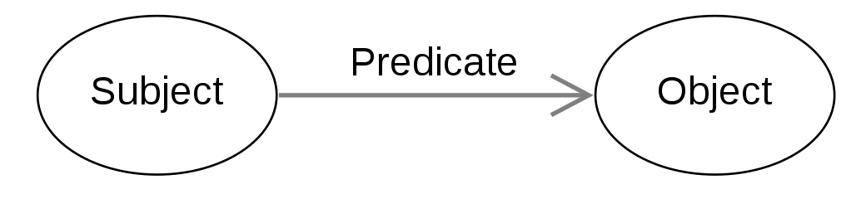

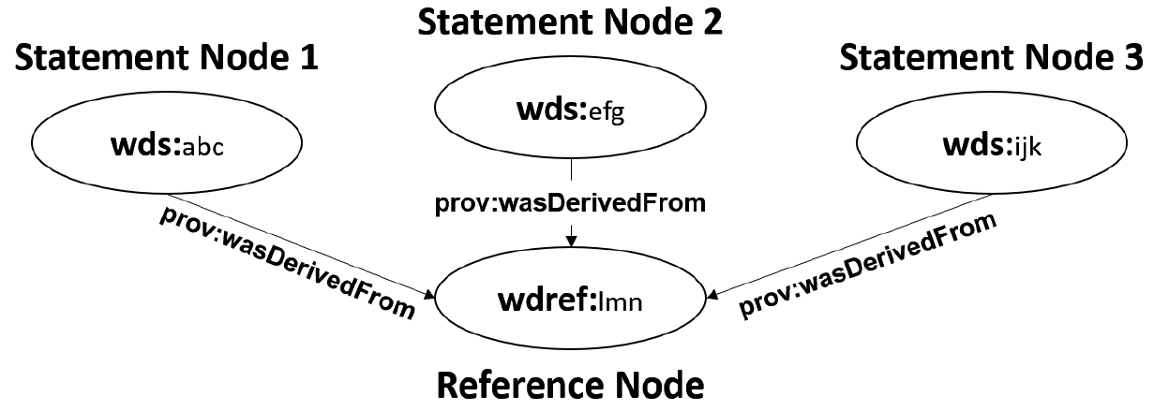
Intrinsic
Domain-Range Checking
Syntax Checking
Conciseness

Slide 21




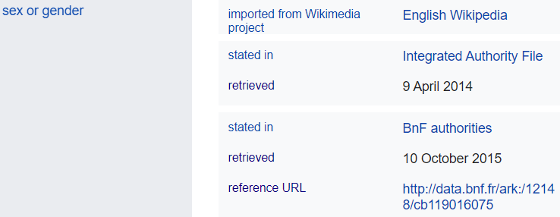
Trust
Pageranks/Blacklisted Pages
Source Type
Human vs. Bot
Multiple Refs

Slide 22
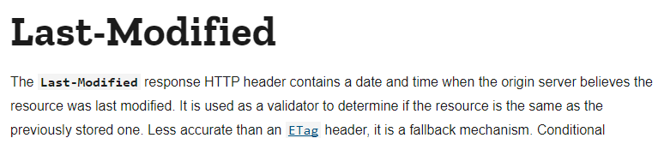

Timeliness
1- How much references ARE FRESH?
2- How much references SHOULD BE FRESH?
ultimate-sitemap-parser
A good approx: <changefreq> of XML sitemaps:

Slide 23



Contextual
Completeness
Schema/instance
Amount-of-data
Relevancy

Slide 24
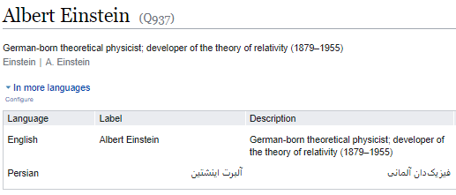
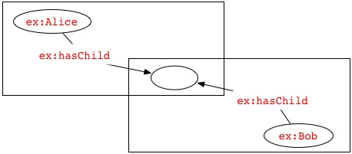
Representational
Versatility
Understandability
Blank Node
Interpretability

Slide 25
Wrapping up…
Wikidata
Problem:
Reference Quality
Subsetting &
Statistics
RQSS:
Referencing Quality Scoring System
Goals & Lessons Learned

Slide 26
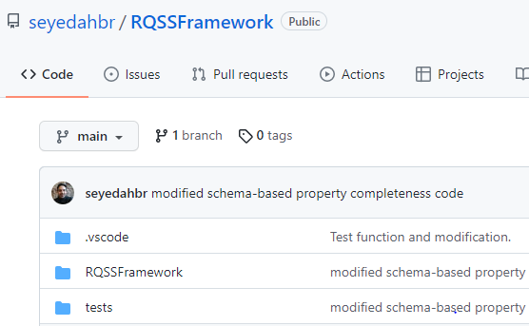
Current Research Status
Implementation
Software Tests
Python unit tests
Small subsets of Wikidata
Ships 2016 (40K items)
Random 1000 (1K items)
Repo: https://github.com/seyedahbr/RQSSFramework

Slide 27
Upcoming Goals
Evaluating the Framework on big actual Wikidata Subsets (Random + Topical)
Name | Items | Statements | References | Referenced Statements
Gene Wiki 2022 | 8M | 95M | 10M | 50%
Music 2022 | 1M | 12M | 1.5M | 587 (75%)
Ships 2022 | 150K | 1M | 60K | 1,005 (75%)
Random 500K (2 of them) | 500K | - | - | -
Random 1M | 1M | - | - | -
Developing RQSS: Framework + weighting system + UI

Slide 28




Lessons Learned
Wikidata 2014
3.5 GB
Wikidata 2021
100 GB
Big Data
Formal Definitions
Subjective Concepts
Edit
History

